Slide 1
Section 5
Networks

Slide 2
Topics covered
5.1 Introduction to networks
5.2 Data Transmission
5.3 Communications Media
5.4 Network hardware
5.5 Communication Protocols

Slide 3
5.1 Introduction
Computer network A collection of computing devices that are connected in various ways in order to communicate and share resources
Usually, the connections between computers in a network are made using physical wires or cables
  However, some connections are wireless, using radio waves or infrared signals
The generic term node or host refers to any device on a network

Slide 4
Types of Networks
Local-area network (LAN) A network that connects a relatively small number of machines in a relatively close geographical area
Wide-area network (WAN) A network that connects two or more local-area networks over a potentially large geographic distance
Notes:
WAN
Often one particular node on a LAN is set up to serve as a gateway to handle all communication going between that LAN and other networks
Communication between networks is called internetworking
The Internet, as we know it today, is essentially the ultimate wide-area network, spanning the entire globe

Slide 5
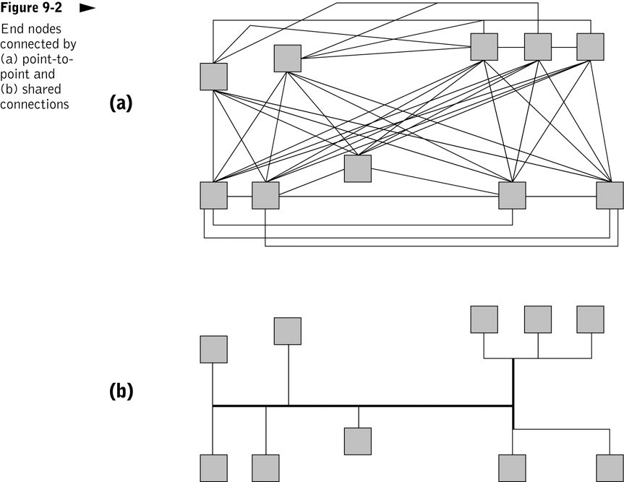
Point-to-point network topology is impractical for all but very small networks.

Slide 6
Types of Networks
Various configurations, called topologies, have been used to administer LANs
  Ring topology A configuration that connects all nodes in a closed loop on which messages travel in one direction
  Star topology A configuration that centers around one node to which all others are connected and through which all messages are sent
  Bus topology All nodes are connected to a single communication line that carries messages in both directions

Slide 7
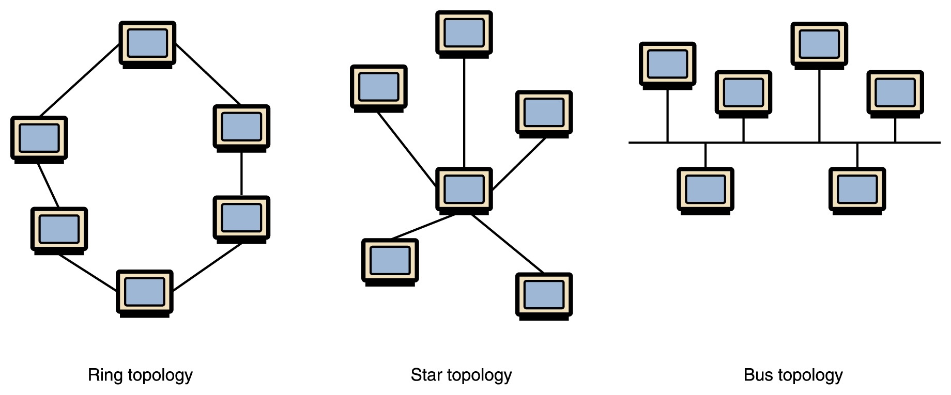
Types of Networks
Figure 15.2 Various network topologies
A bus technology called Ethernet has become the industry standard for local-area networks

Slide 8
Client/Server Network
Central Server computer controls network
  Often has several hard drives, fastest printer
Client requests services from server
  Thin client has little or no storage
Services supplied
  Web server
  File server
  Print server
Notes:
Server - a powerful microcomputer that manages shared devices
File server - a computer that acts like a disk drive, storing the programs and data files shared by users on a LAN.
Print server - controls one or more printers and stores the print-image output from all the microcomputers on the system.
Web server - contains web pages that can be viewed using a browser.

Slide 9
Peer-to-Peer Networks
All computers have equal status
Users share each other’s files, printers, etc. as needed
Common in small offices
Networks tend to be slow

Slide 10
5.2 Data Transmission
Digital
  Sends data as distinct pulses, either on or off Similar to how data travels through computer
Analog
  Continuous electrical signal in the form of a wave, called carrier wave
  Many communications media already in place for analog (voice) transmission. Phone lines are most common
Notes:
Phone lines from house to mervue are analog copper.
Rest of network is digital
Analog - Use full range of carrier wave characteristics to encode continuous data values
Can represent any data value within a continuum of values
Digital - Sends data as distinct pulses, either on or off Similar to how data travels through computer
Can contain one of a finite number of possible values
Pulse code modulation (PCM)
Binary data transmission via square waves
Square waves preferred over short distances

Slide 11
Carrier Waves
A sine wave with encoded bits (transports bits from one place to another)
Characteristics of sine waves: amplitude, phase, frequency
Importance of waves in communications
  Travel through space, wires, and fibers
  Can have patterns encoded in them

Slide 12
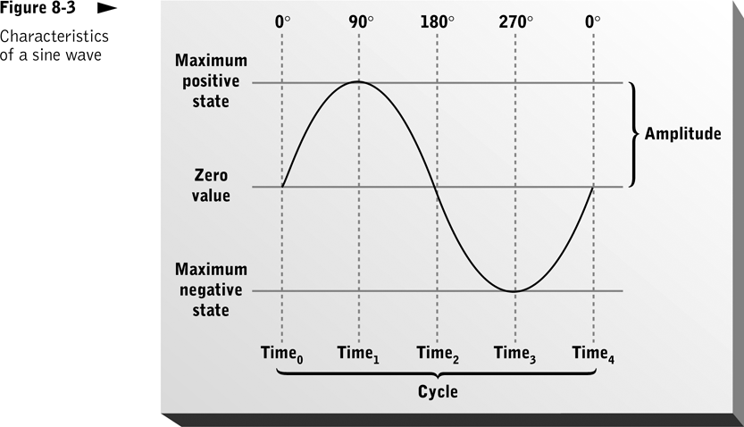

Slide 13
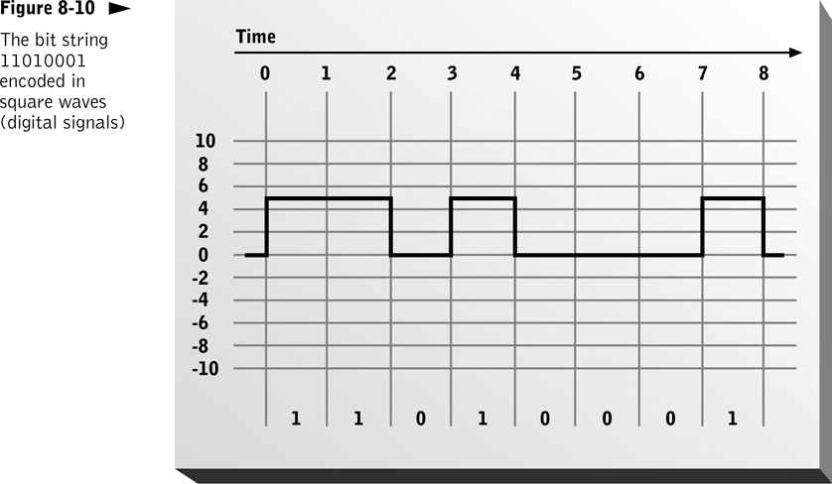

Slide 14
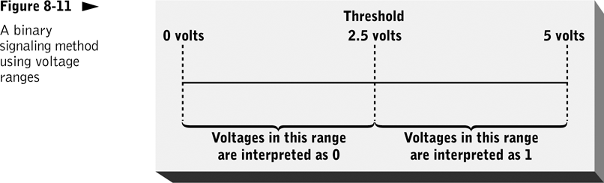
A digital signaling scheme defines a range of wave characteristic values to represent each bit value.

Slide 15
Modulation Methods
Techniques used to encode bits in sine waves
  Frequency modulation (FM)
  Amplitude modulation (AM)
  Phase shift modulation
  Multilevel coding

Slide 16
Converting Digital to Analog
Digital signal from computer must be converted to analog form to be transmitted over analog lines
Conversion from digital to analog called modulation
Conversion from analog to digital called demodulation

Slide 17
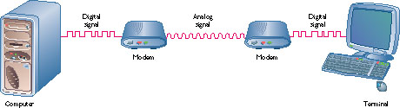
Modem
Short for modulator/demodulator
Converts digital signal to analog and vice versa
Notes:
Transmission on phone lines treated like a voice message
Internal modem inserted into computer
Standard on most computers today
PC Card modem slides into slot on laptop
Roughly credit card size (PCMCIA card)
Cable connects modem to standard phone jack
Modem speed measured in bits per second (bps)
Fastest current modems transmit at 56,000 bps

Slide 18
Internet Connections
There are various technologies available that you can use to connect a home computer to the Internet
  A phone modem converts computer data into an analog audio signal for transfer over a telephone line, and then a modem at the destination converts it back again into data
  A digital subscriber line (DSL) uses regular copper phone lines to transfer digital data to and from the phone company’s central office
  A cable modem uses the same line that your cable TV signals come in on to transfer the data back and forth
Notes:
Internal modem inserted into computer Standard on most computers today
PC Card modem slides into slot on laptop Roughly credit card size (PCMCIA card) Cable connects modem to standard phone jack
Modem speed measured in bits per second (bps) Fastest current modems transmit at 56,000 bps
PCMCIA _ personal Computer Memory Card International Association Line conditions limit sending to about 30K on phone lines
ISP – Internet Service Provider
Uses advanced electronics to send data over telephone line at very high speeds Always on - no need to dial a connection Can use phone while online
Drawbacks You must be within three miles of telephone company’s switching office That office must have DSL equipment
Integrated Systems Digital Network ISDN Special type of telephone circuit Can move data at 128,000 bps Includes two phone lines, so you can talk on the phone while online
Drawback Expensive, especially at installation Not available in all areas
Cable Uses coaxial cable already in place for your TV Very fast transmission speed, especially for downloading Always on: no need to dial a connection
Drawbacks All users share a cable segment’s capacity As more users in neighborhood go online, speed decreases
No security for individual users or data Purchase a firewall program for security

Slide 19
Speed and Capacity
Interdependent; jointly described as data transfer rate (raw versus effective data transfer rate)
Factors that account for transmission speed differences among media
  Length of media
  Ways in which multiple media segments are interconnected
  Rate at which bits are encoded in signals and recognized by the receiver

Slide 20
Frequency and Bandwidth
Carrier wave frequency
  Fundamental measure of data-carrying capacity (i.e., limits capacity)
Bandwidth
  Difference between maximum and minimum frequencies of a signal
  High-bandwidth channels can carry multiple messages simultaneously
  Example

Slide 21
Signal-to-Noise (S/N) Ratio
Measure of the difference between noise power and signal power
Effective data transfer rate can be much lower than raw data transfer rate due to
  Electromagnetic interference (EMI)
  Attenuation
  Distortion
  Internal or external noise

Slide 22
5.3 Communications Media
Physical means of data transmission
Bandwidth is measure of the capacity of the communications link

Slide 23
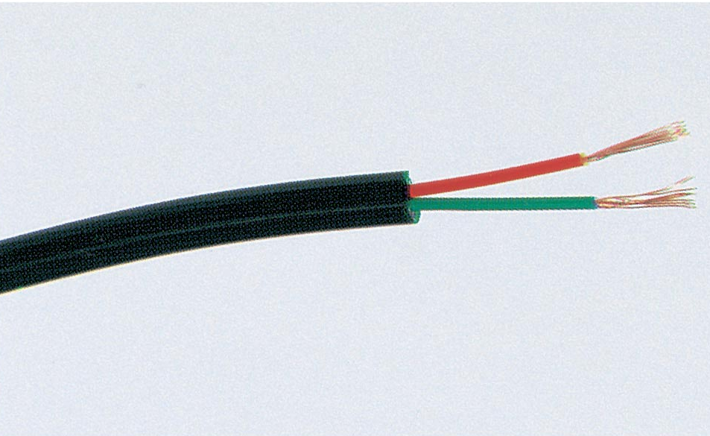
Electrical Cabling
Transmits signals through copper wire
Two types
  Twisted pair
    Relatively cheap; limited in bandwidth, S/N ratio, and transmission speed
  Axial (coaxial and twin-axial)
    More expensive; offers higher bandwidth, greater S/N ratio, and lower distortion; resistant to EMI
Notes:
Co-axial - Single Central copper wire surrounded by insulation and metal casing
Also known as twisted pair Two wires twisted around each other to reduce electrical interference
Inexpensive
Already in place (for telephone systems)
Susceptible to electrical interference and noise
Noise - anything that causes signal distortion

Slide 24
Optical Cabling
Provides very high bandwidth, little internally generated noise and distortion, immunity to EMI
Requires amplifiers and repeaters for long distances to increase signal strength and remove noise and distortion
Notes:
Use light instead of electricity to send data
Much higher bandwidth than coaxial cable
Immune to electrical interference
Materials cheaper than coaxial, but installation costs high
Light transmitted 0 and 1s and not electricity
Glass fibre thinner than a hair
No corrosion from water
Needs special microscopic equipment for joins
Now used for all long distance transmission
Also used for broadband distribution in Galway

Slide 25
Wireless Data Transmission
Uses shortwave radio or infrared light waves to transmit data through the atmosphere or space
Advantages
  Relatively high bandwidth, avoidance of wired infrastructure, simultaneous broadcast transmission
Disadvantages
  Susceptibility to external interference, cost, high demand for unused radio frequencies, ability to be “overheard”

Slide 26
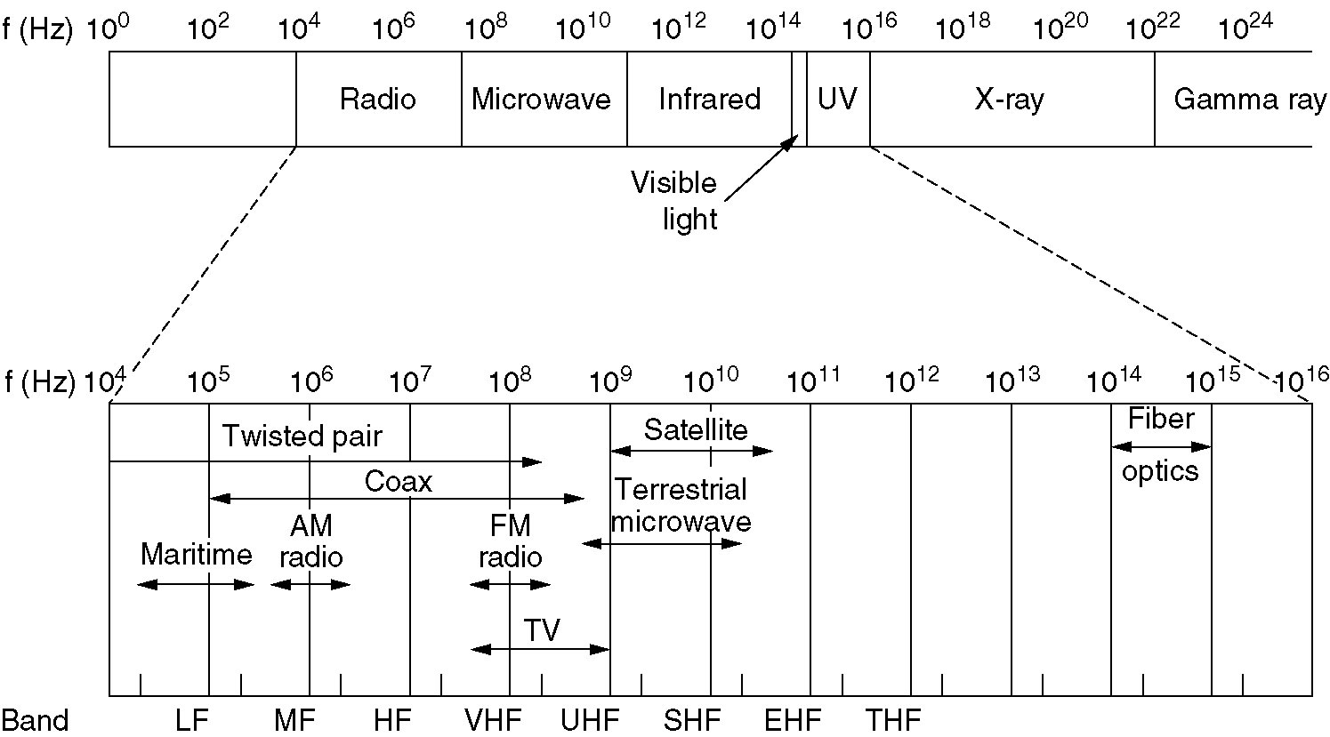
The Electromagnetic Spectrum

Slide 27
A few Questions
Difference between digital and analog?
Why use digital?
Why use a base 2 or 16 numbering system?
What is bandwidth and what is it typically measured in?
What is main memory?
What does an ALU do?
What is a gate?
What is RAM (some characteristics)?
Why is a track on a CD-ROM continuous?

Slide 28
Microwave Transmission
Uses line-of-sight transmission of data signals
  Sending microwave must “see” receiver
Requires relay stations approximately every 30 miles
  Waves are straight, earth is curved
Offers high speed and cost-effectiveness
Susceptible to weather conditions
Notes:
Mervue tower – Tuam tower

Slide 29
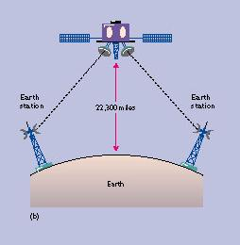
Satellite Transmission
A form of microwave transmission
  Satellite acts as relay station
Components
  Earth station sends and receives signal to satellite
  Transponder receives and amplifies signal, changes frequency, and retransmits data
Useful when signal must travel thousands of miles
Notes:
Can be low level 1000 miles up or 22300 miles up where they automatically stay in one position

Slide 30
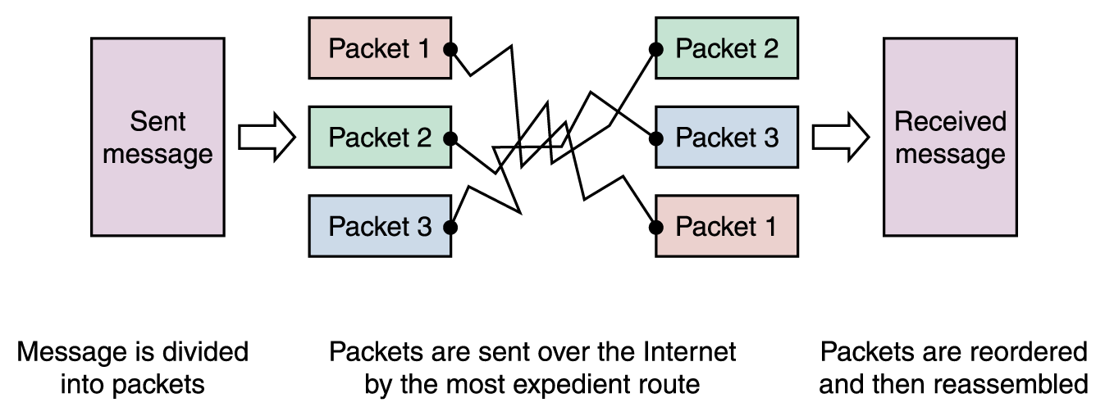
5.4 Network hardware
To improve the efficiency of transferring information over a shared communication line, messages are divided into fixed-sized, numbered packets
Network devices called routers are used to direct packets between networks
Figure 15.4
Messages sent by packet switching

Slide 31
Local Area Network Routing
Each central node (computer) maintains and uses a routing table to make routing decisions
LAN hub or switch (physical forwarding device) usually handles packet routing
Logical network topology determines exact procedure for routing a message between two end nodes in the same LAN

Slide 32
Wide Area Network Routing
Packet routing uses a store and forward approach
Forwarding stations can be implemented using bridges, routers, and switches

Slide 33
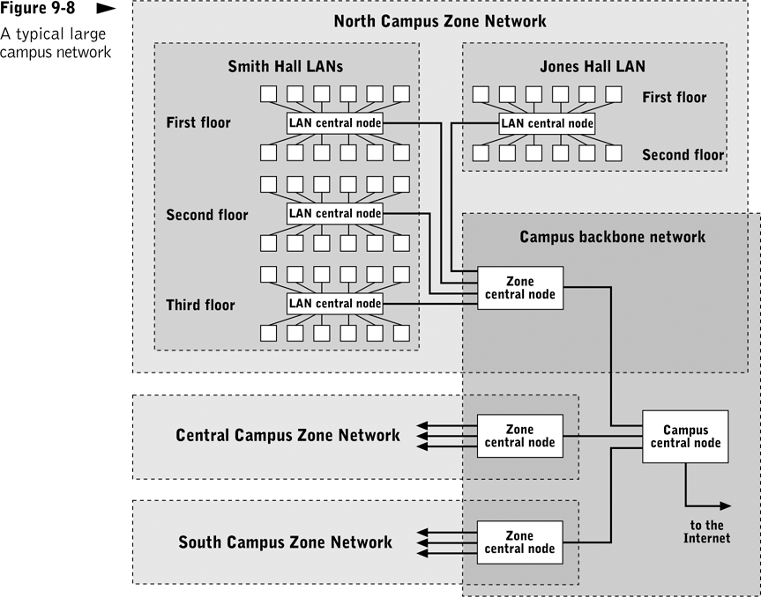
Example of a WAN including end nodes, LANs, zone networks, the campus backbone network, and central nodes.

Slide 34
Network Interface Card
Connects each computer to wiring in the network
  Handles sending, receiving, and error checking of transmitted data
Can be a circuit board or PC card
Wireless NIC allows user to connect through wireless access point

Slide 35
Hubs
Connect nodes to form a LAN
Most are Ethernet devices
Combine separate point-to-point connections between nodes and the hub into a single shared transmission medium by repeating all incoming packets to every connection point
Low-cost alternative for home and small office networks

Slide 36
Bridges
Connect two networks or network segments and copy packets between them
Look at source addresses and update internal tables of node addresses on each network segment
Common uses
  Construct a virtual LAN from two separate LANs
  Divide a network into segments in order to minimize congestion

Slide 37
Routers
Intelligently route and forward packets among two or more networks
Forward packets based on information other than destination address
Build internal “map” of the network; constantly scan it to monitor traffic patterns and network node changes
Notes:
Bridge allows connection of similar networks (those using the same protocol)
Router directs communications traffic when several networks connected together
If network traffic clogged, router can redirect traffic to another route
IP switch used in place of router when networks use the Internet protocol
Less expensive and faster than routers

Slide 38
5.5 Communication Protocols
Protocol - a set of rules for the exchange of data between a terminal and a computer or two computers
  Agreement on how data is to be sent and receipt acknowledged
  Transmission Control Protocol/Internet Protocol (TCP/IP) permits any computer to communicate with the Internet
  Ethernet – LAN protocol for computers that share network access.
Notes:
TCP/IP protocol agreed messages and data transmission rules
TCP breaks message into packets for sending and reassembles at other end
IP is responsible for the routing and addressing
Set of rules and conventions for communication
Message content and format
Bit encoding
Signal transmission
Transmission medium
Channel organization

Slide 39
Open Systems
Proprietary system A system that uses technologies kept private by a particular commercial vendor
  One system couldn’t communicate with another, leading to the need for
Interoperability The ability of software and hardware on multiple machines and from multiple commercial vendors to communicate
  Leading to
Open systems Systems based on a common model of network architecture and a suite of protocols used in its implementation

Slide 40
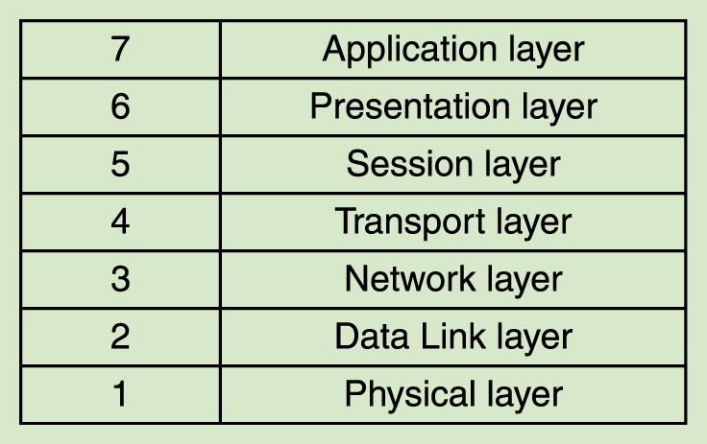
Open Systems
The International Organization for Standardization (ISO) established the Open Systems Interconnection (OSI) Reference Model
Each layer deals with a particular aspect of network communication
Figure 15.5 The layers of the OSI Reference Model

Slide 41
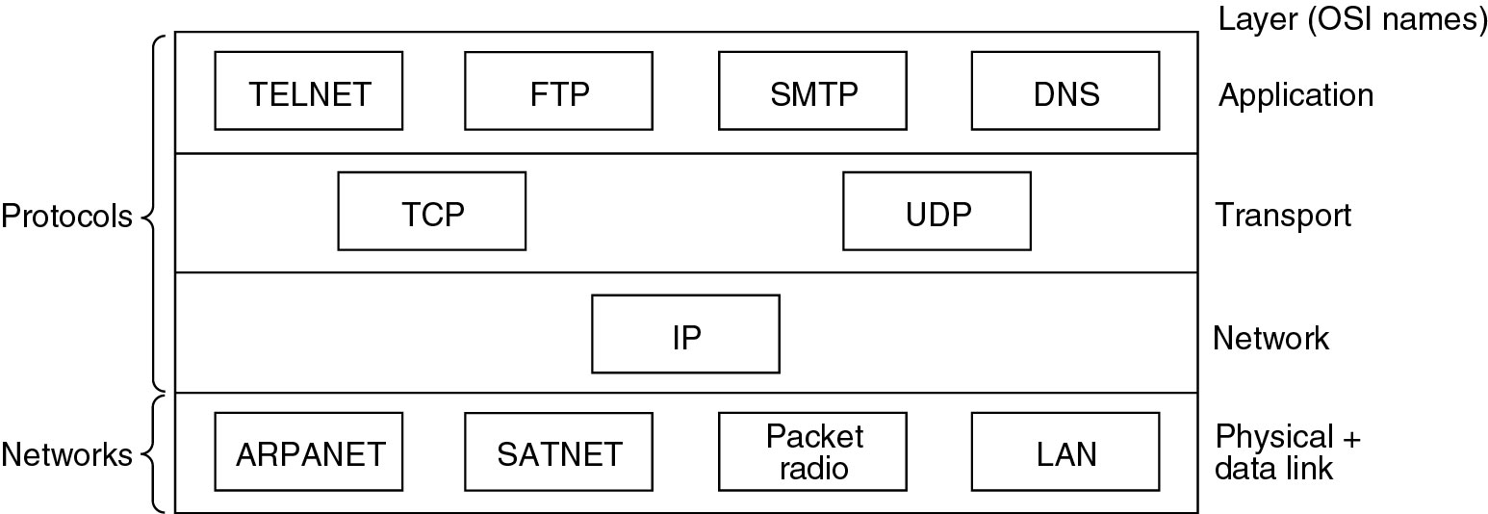
Compare Reference Models

Slide 42
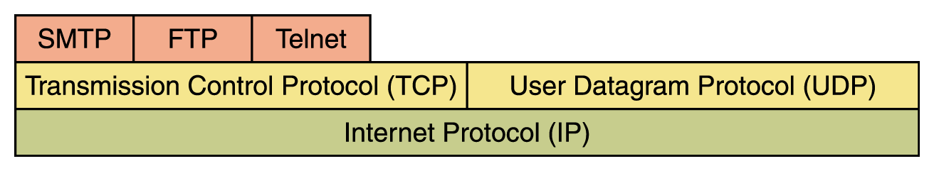
Network Protocols
Network protocols are layered such that each one relies on the protocols that underlie it
Sometimes referred to as a protocol stack

Slide 43
Advantages of Protocol Stacks
Divide network interaction into well-defined pieces that can be separately implemented, installed, and updated
Provide flexibility to keep up with rapid protocol standard evolution
Insulate application programs and portions of OS from details of low-level network communication protocols and physical network implementation (ensures software portability)

Slide 44
TCP/IP
TCP stands for Transmission Control Protocol
  TCP software breaks messages into packets, hands them off to the IP software for delivery, and then orders and reassembles the packets at their destination
IP stands for Internet Protocol
  IP software deals with the routing of packets through the maze of interconnected networks to their final destination

Slide 45
Transmission Control Protocol
Provides connection-oriented packet transport to higher-level Internet service protocols, including HTTP, FTP, and Telnet
  Provides framework to check for lost messages; explicitly establishes connection with intended recipient before transmitting messages
Performs connection management functions (verifying receipt, verifying data integrity, controlling message flow, securing message content)
Notes:
Sender and recipient TCP layers maintain information about one another (message routes, errors encountered, transmission delays, status of ongoing data transfers)
Uses positive acknowledgment protocol to ensure data delivery
Establishes connections through a port and an socket

Slide 46
Internet Protocol
Provides connectionless packet transport across LANs and WANs
Translates datagrams into format suitable for transport by physical network
Connectionless orientated
IP layer can divide datagram into smaller units and transmit them individually
  Attaches header information to each unit, including its sequence in the datagram

Slide 47
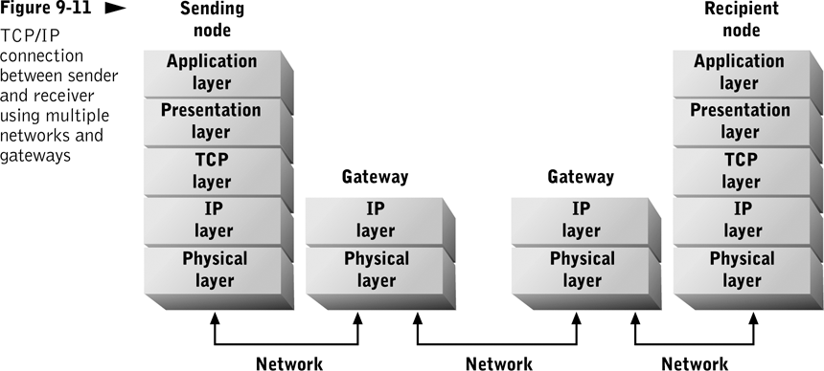
Only the IP layer is implemented within the gateways.

Slide 48
Wireless Standards
  IrDA - uses infrared line-of-sight
  Bluetooth - uses radio waves to connect mobile devices
  802.11 standards - govern wireless transmission
Notes:
3G standard
WAP
Bluetooth links PDAs and computers and peripherals up to 30feet
WiFi short distance up to 300ft sharing access to internet
1G analog voice wireless cell phones
2G digital transmission of voice and data
3G multimedia always on internet access music /video
2.5G always on using 2G

Slide 49
Voice over IP (VoIP)
Technologies/standards that carry voice messages and data over single packet-switched network
Lower cost than traditional public switched telephone network (PSTN)
Complex and competing standards
Transmission quality problems (packet loss, latency, jitter)
Connection orientated

